Slide 1
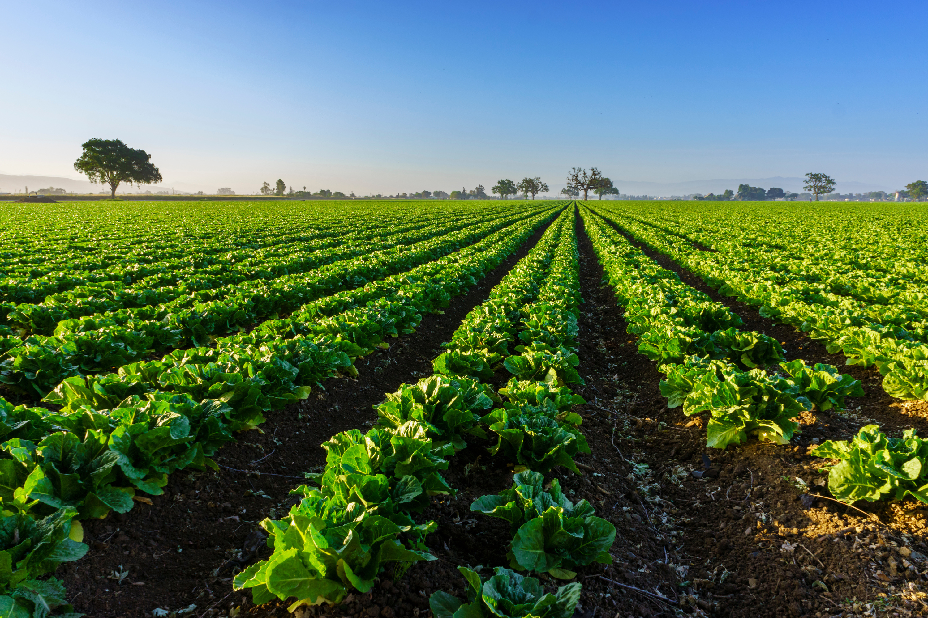
https://www.kyagr.com/consumer/senior-farmer-market.html
FOODS DIVISION
SENIOR FARMERS MARKET NUTRITION PROGRAM
Kentucky Department of Agriculture
Presented by:
Jesse Frye
Tina Garland
Stephanie Stefanic

Slide 2
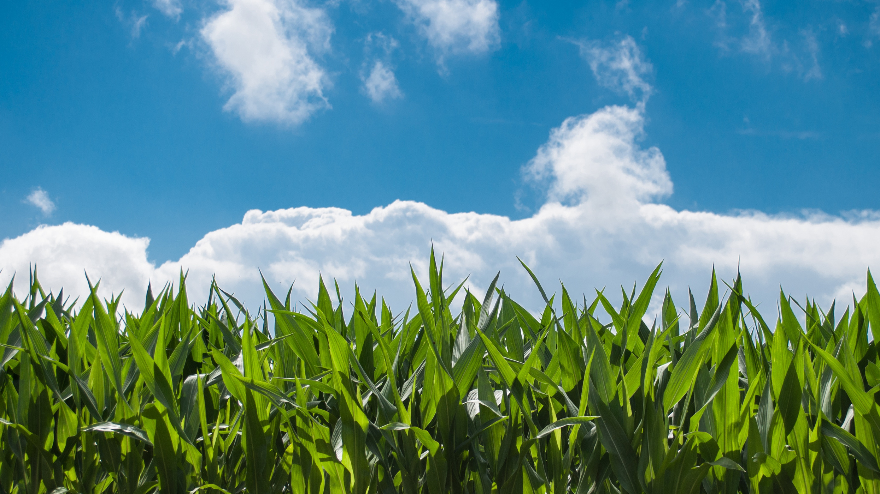
STATISTICS
2023 year end redemption rate was 78%
12,073 issued cards in 2023 and 12,067 used at least some of the benefits
7,451 (61.7%) used the entire amount of benefits
43,931 Market Transactions
Average Transaction $10.76
Total Sales $472,650 up from $356,060 in 2022 from an available $476,535
Average sale for Participating Farmer was $925 up from $858
16 Farmers Claimed more than $5,000 in sales up from 13 in 2022

Slide 3
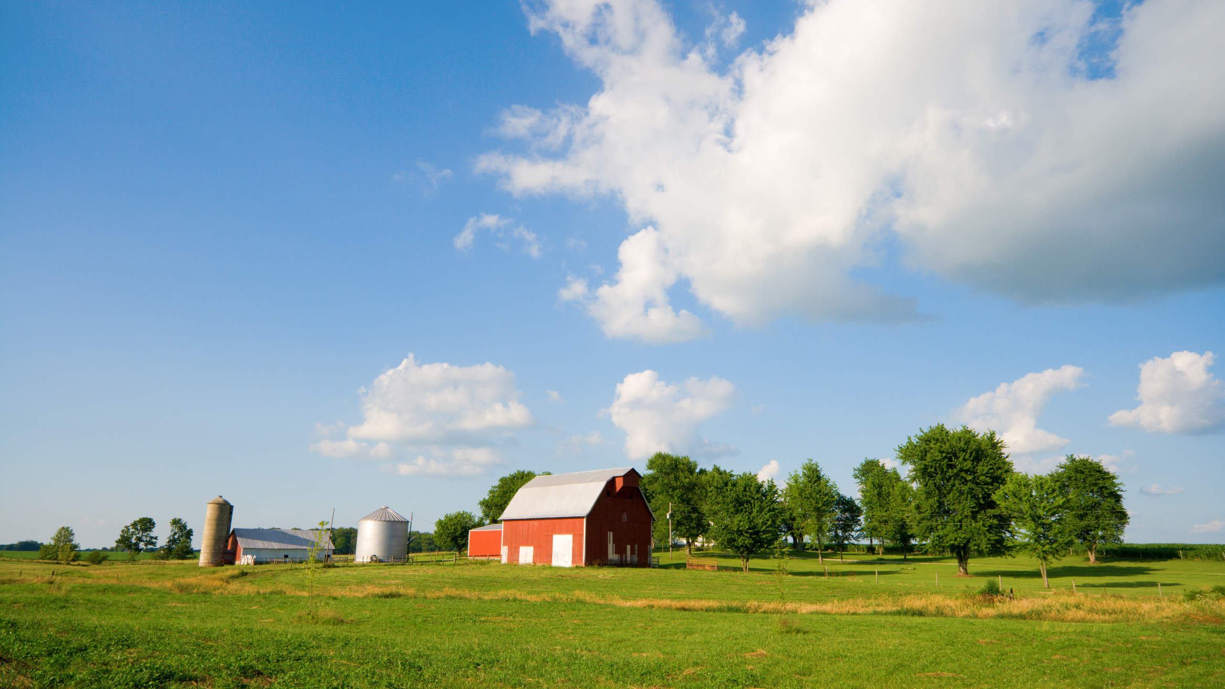
2023 A HUGE SUCCESS
We, KDA, would like to thank the 115 Farmers’ Markets and 98 Distribution Agencies who did not waiver in the face of change to make all this happen for the seniors of Kentucky. Approximately 12,073 seniors received benefits.

Slide 4
Qualifications for Farmers’ Markets
The market must be an organized market. To be considered “organized,” the market must have an established contact person/decision maker and meet at a named location at least once a week during the market season with specified days and operating times.
The market must experience one full growing season as a registered KDA market before submitting a new market application to the SFMNP.
The market must be registered with KDA and approved as a Kentucky Proud market.
The market must sell locally grown fresh produce. Locally grown means grown in Kentucky or within 50 miles of the Kentucky border.

Slide 5
Qualifications for Farmers/Vendors
Be a member of an approved KDA and SFMNP Farmers’ Market.
Must attend a KDA approved training session each year and train employees selling at the market on SFMNP procedures.
Post SFMNP sign, provided by KDA with individual identifier (farm) number, at market booth to identify as a vendor.
Offer for sale locally grown fruits, vegetables, honey and cut cooking herbs on the eligible foods list for human consumption. Locally grown means grown in Kentucky or within 50 miles of the Kentucky border.
Provide eligible foods to senior participants at, or less than, the price charged to other customers.

Slide 6
Qualifications for Farmers/Vendors
Accept SFMNP benefits through an app at only authorized SFMNP Farmers’ Markets.
Must have a bank account set up in which payments may be made ACH deposit for market transaction(s).
Provide information to KDA pertaining to the Kentucky SFMNP as required for periodic reports to USDA FNS.
Agree to be monitored for compliance both at the market and on-site farm visits.

Slide 7
VALUE
With the ARPA Grant KDA SFMNP was able to add 8 new counties
We were also able to add both Farmers Markets and Distribution Agencies to already existing counties.
With the ARPA Grant funding we were able to hire an additional SFMNP Coordinator allowing the program to be split into an East and West region.
SFMNP can be a positive financial addition to your already existing farm plan or Farmers Markets.

Slide 8
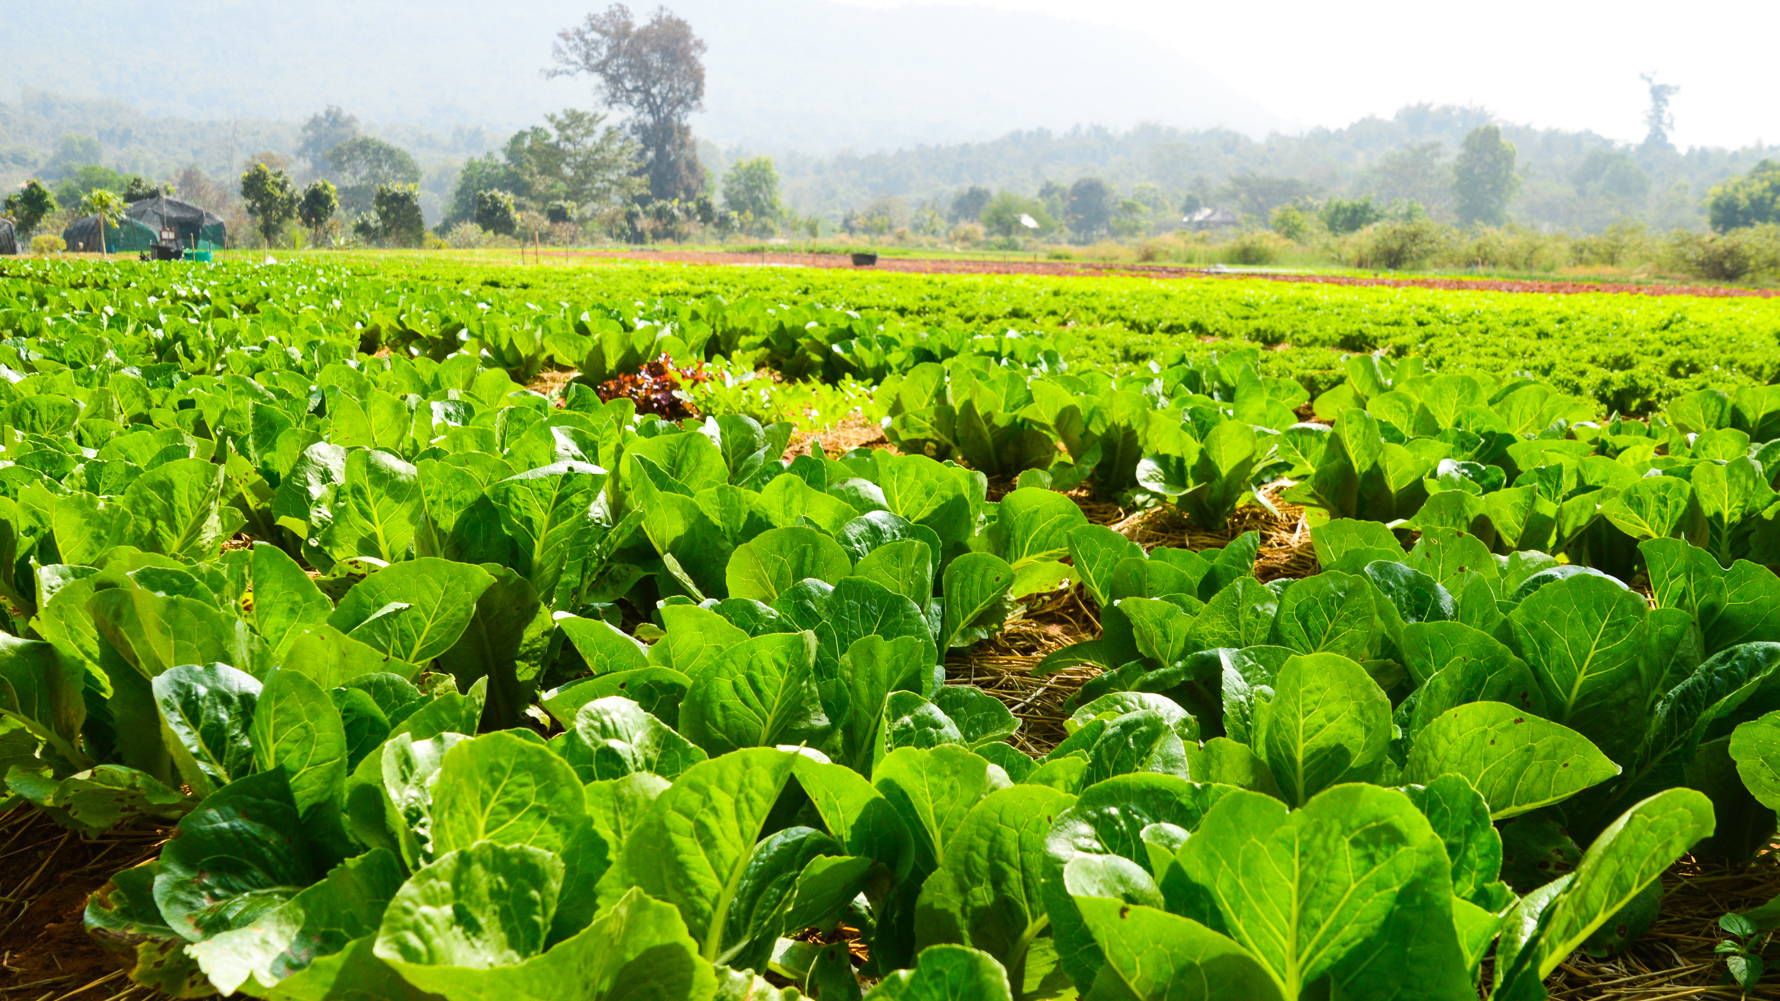
SFMNP SoliMarket
Mobile app for farmers and cashiers
Available through the apple store or google play
Free to download and use
Activation is through invitation only for farmers and cashiers authorized by SFMNP Coordinators or Branch Manager
Link to activate account is emailed to user
Farmer/Vendor needs to enter banking information for deposits
Mobile devices must have a working network connection to perform transactions
Geofencing only allows transactions to be made at designated markets
https://solisystems.atlassian.net/wiki/spaces/~945527616/pages/7625998345/SoliMarket+-+User+Guides+Resources

Slide 9
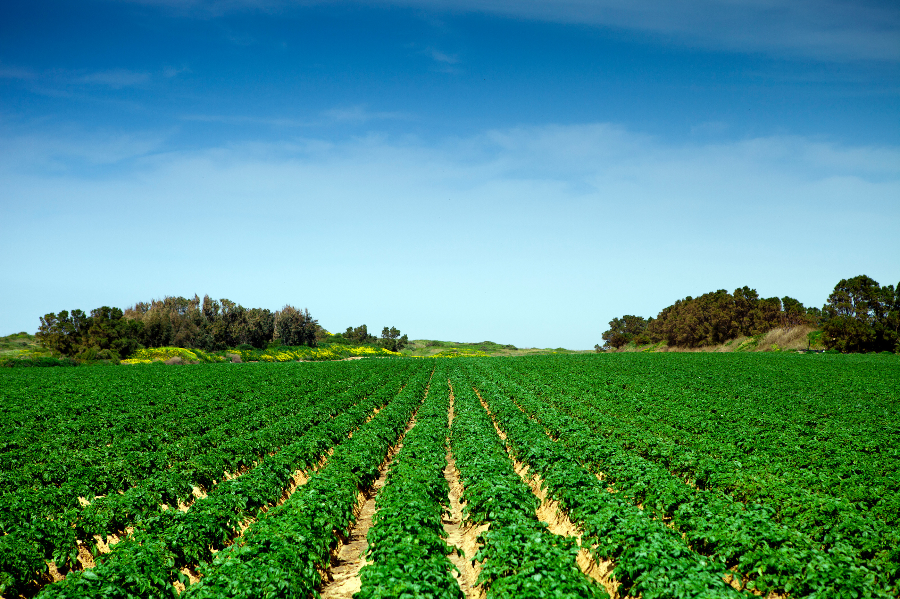
Distribution Agents Procedures
Accept and review all senior applications for eligibility. Qualifying applications must be signed, dated and kept on file.
Proxy forms must be filled out and signed by any seniors requesting a proxy or proxies.
One senior per card (no couples cards). If a couple qualifies, each senior receives his/her own card.
Each senior (or proxy) must sign the issuance log at time of issuance. Due September 1st of program year.

Slide 10
Distribution Agents Procedures
Only distribute according to budgeted amount. This can be monitored via the portal dashboard. As benefits are distributed, total available funding should decrease. This may not be in real time and refreshing may be necessary.
NEW THIS YEAR: Seniors will be issued a new card; you will not load benefits on last year's card.
Please maintain a waitlist and send the SFMNP Coordinator or Branch Manager a request as such. Should funds become available, they will be distributed first come, first served, by date/time stamp of waitlist request email.

Slide 11
Distribution Agents Procedures
Please maintain a waitlist and send the SFMNP Coordinator or Branch Manager a request as such.
Should funds become available, they will be distributed first come, first served, by date/time stamp of waitlist request email.
Public notification of the SFMNP
Display in prominent places, program opportunities and benefits to participants (or potential) and the USDA Title VI nondiscrimination poster
Have the capability of providing the above information in a multilingual manner

Slide 12
Distribution Agency Dates
April
1
September
1
May
1
October
31
Contract due to KDA
Issuance Log due to KDA
Start of SFMNP season
End of SFMNP season

Slide 13
SoliMarket Portal
Website for distribution agents to assign benefits to qualifying seniors.
Activation is through invitation only for distribution agents authorized by SFMNP Coordinators or Branch Manager. A link to activate an account is emailed to user.
Geofencing only allows seniors and/or proxies to make transactions at designated markets.

Slide 14
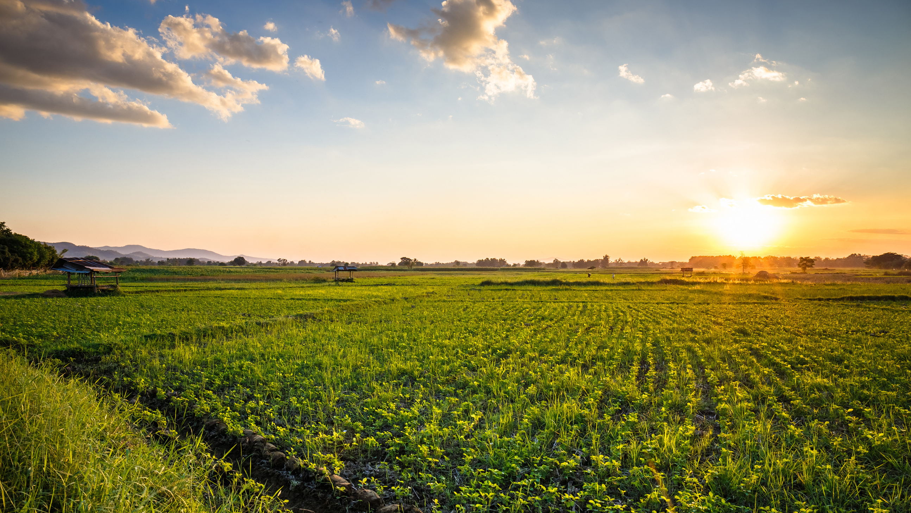
Benefit Cards
The shopper card is similar in form to a standard credit/debit card.
It is custom printed according to the state requirements.
Each card is unique with a 16-digit account number and QR code.
The 2-digit code in front of the 16-digit number from the card on the application/eligibility form will be needed when adding benefits to the account.

Slide 15
Benefit Cards
The card is secured with a participant PIN code. The participants PIN code will be the last 4 digits of the 16-digit number.
To use, the senior or proxy will give to the farmer/vendor to scan the QR code with the device containing the app.
Transaction may be in any amount, up to the dollar value of benefits on the card. The transaction does not have to be in whole dollar amounts.

Slide 16
SoliMarket Portal Review
Q&A

Slide 17
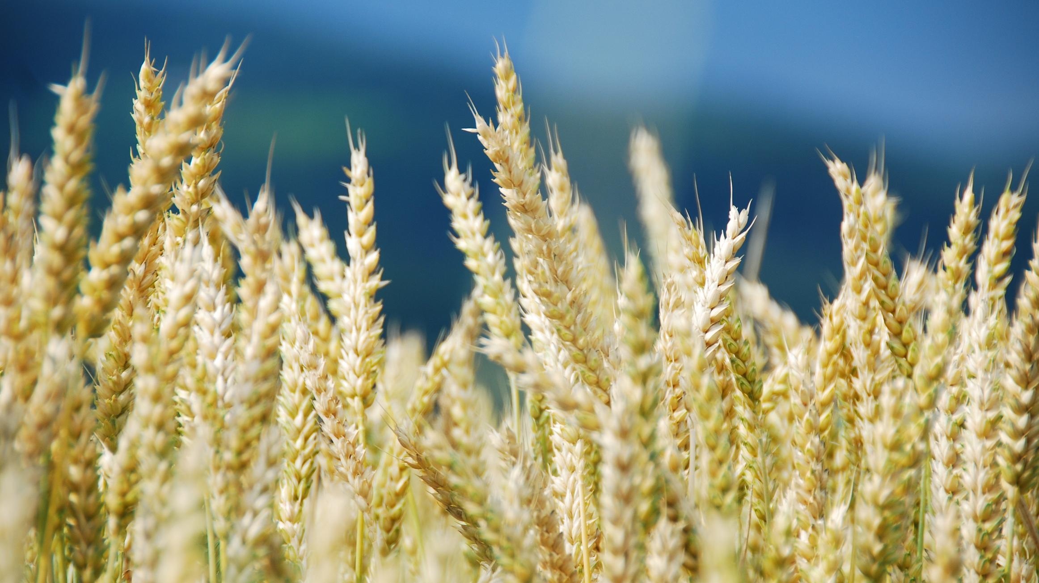
SOLIMARKET RESOURCES
SoliMarket support hotline: 214.256.3083

Slide 18
www.kyagr.com
Kentucky Department of Agriculture
Division of Food Distribution
107 Corporate Drive
Frankfort, KY 40601
502.573.0282
SFMNP Coordinators:
Jesse Frye, Jesse.Frye@ky.gov Cell: 502.382.7458
Stephanie Stefanic, Stephanie.Stefanic@KY.gov Cell: 502.401.9908
Branch Manager
Tina Garland, Tina.Garland@ky.gov Cell: 502.382.7505

